Slide 1


Slide 2

Bill Mortimer
Chair, IoT Community Advisory Board and
Vice President, Strategic Marketing, Spirent
bill.mortimer@spirent.com
+49.151.7230.5159 (Germany)

Slide 3



To accelerate the adoption & application of IoT
in commercial environments to realize economic benefit
OBJECTIVE
Enterprises and organizations in different vertical segments
SCOPE
Internet of Things (IoT) Industry Practioners
TARGET
IoT Community
Virtual Conferences & Exhibitions
INITIATIVES
Notes:
As an IoT Community, we want practioners to come together to network with other practioners and to share their best practices…. and perhaps some of our not-so-best practices… from which we have learned some valuable lessons. We want to enable and facilitate discussion and work on solutions to accelerate the adoption of IoT-enabled applications in commercial environments.
We strongly believe we need to understand the opportunities in the different vertical segments that IoT can benefit. We seek to deeply understand the similarities and differences of the vertical segments, and to bring the best practices and best information to the practioners working across the industry.
As concrete initiatives to realize these objectives, we have formed the LinkedIn IoT Community and have organized these IoT Slam virtual conferences and exhibitions:
1) At present, there are over 13,300 members in the LinkedIn IoT Community. As you know, LinkedIn provides a forum for sharing information and insights and for facilitating discussions. We hope to keep that group current, active and insightful.
2) We decided to create the IoT SLAM virtual conference and exhibition … seeking to make it accessible to everyone. We got off to a very good start with the inaugural IoT SLAM in December 2015, and, today, we hold the second IoT SLAM.

Slide 4




Successful Series of Virtual Conferences
December 2016
April 2016
December 2015

Slide 5



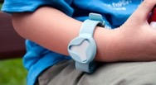
Challenges
Chrysler Jeep hacked
over internet
(July 2015)
Multiple standards initiatives which lack unification & ratification
New security threats, vulnerabilities & attack surfaces
Management & control of remote devices in the field for years
Volume/Variety of devices requiring different testing, qualification & quality
Explosion in number of connections & diverse call models to the network
New developers lacking expertise in network comms, IP/IT security …

Slide 6
Solutions Wanted
1
Develop
Certify
Simplify & Accelerate
2
2
Safe & Secure
3
Operate, Manage & Optimize
Operate
Launch

Slide 7
Application Verticals
Health
Weather
Industrial
Enterprises
Health
Smart Cities
Weather
Industrial
Transportation

Slide 8
Application Verticals
Health
Weather
Industrial
Enterprises
Health
Smart Cities
Weather
Industrial
Transportation

Slide 9
Application Verticals
Health
Weather
Industrial
Enterprises
Health
Smart Cities
Weather
Industrial
Transportation

Slide 10

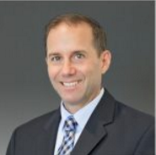
Chris Sullivan
Health SLAM Advisory Board Chair
Global Healthcare Practice Lead,
Zebra Technologies

Slide 11
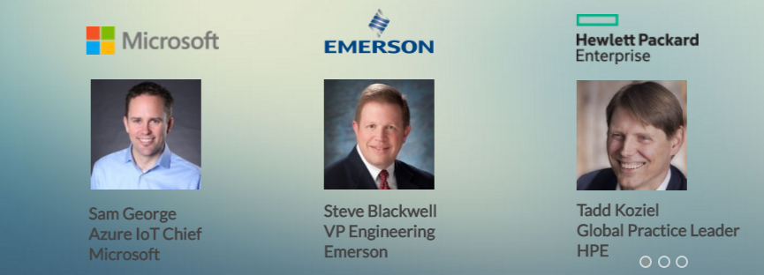
Keynote Speakers (later in the day)

Slide 12
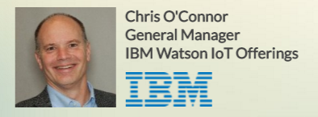
Opening Keynote Speaker
“Driving Exceptional Outcomes with the Internet of Things”

